Slide 1


Akhil T V
26/10/2025

Slide 2

Outline
Executive Summary
Introduction
Methodology
Results
Conclusion
Appendix

Slide 3
Executive Summary
This project focuses on predicting the success of SpaceX Falcon 9 first-stage landings using data science techniques. The primary objective is to identify the key factors influencing launch outcomes and build a reliable predictive model. A successful prediction model provides insights that can help reduce launch costs and improve operational efficiency for future missions.
The data was collected from the SpaceX API and Wikipedia, followed by cleaning, wrangling, and feature engineering. Extensive Exploratory Data Analysis (EDA) was performed using SQL, Matplotlib, Seaborn, and interactive visualizations with Folium and Plotly Dash to uncover hidden patterns.
Several machine learning models, including Logistic Regression, Support Vector Machine (SVM), K-Nearest Neighbors (KNN), and Decision Tree classifiers, were developed and compared. The Decision Tree model achieved the highest accuracy, effectively predicting launch success with strong interpretability.
The entire workflow demonstrates how data science integrates multiple analytical steps — from data acquisition to visualization and modeling — to derive actionable insights for real-world aerospace applications.

Slide 4
Introduction
SpaceX has revolutionized space travel by successfully reusing rockets, significantly reducing launch costs. A key determinant of this cost efficiency is the ability of the Falcon 9 first stage to land successfully after launch.
Predicting whether a Falcon 9 rocket will land successfully is essential for mission planning, cost optimization, and risk management. By analyzing past launch data and applying data science methods, we can uncover patterns that influence landing outcomes, such as payload mass, orbit type, launch site, and booster version.
This project applies machine learning and exploratory data analysis (EDA) to build predictive insights from historical SpaceX data. The ultimate goal is to determine the factors that most strongly affect landing success and create a model that accurately predicts future outcomes.

Slide 5

Section 1

Slide 6
Methodology
Data Collection Methodology
Data was collected from SpaceX REST API and Wikipedia using API calls and web scraping.
The dataset included information about launch dates, payload mass, booster version, landing site, and success status.
Data Wrangling
Cleaned and processed raw data using Pandas.
Replaced missing payload mass values with the mean, converted data types, and removed redundant columns.
Created a new binary target variable (class) to represent landing success (1) or failure (0).
Exploratory Data Analysis (EDA)
Conducted EDA using Matplotlib, Seaborn, and SQL queries.
Identified correlations between payload, orbit type, and success rate.

Slide 7
Visualized trends across years and launch sites.
Interactive Visual Analytics
Used Folium maps to visualize launch site locations and outcomes.
Created Plotly Dash dashboards for interactive exploration of payload and success trends.
Predictive Analysis
Built, tuned, and evaluated classification models (Decision Tree, K-Nearest Neighbors, Logistic Regression, and SVM).
Optimized models using GridSearchCV to identify the best hyperparameters.
Achieved over 90% accuracy in predicting landing success.

Slide 8
Data Collection
Primary Data Sources:
SpaceX REST API (for launch records and rocket information)
Wikipedia (for payload details, mission names, and launch outcomes)
Collection Techniques:
Accessed structured data through API calls using Python’s requests library.
Extracted unstructured data from Wikipedia using web scraping (BeautifulSoup).
Combined and standardized both sources into a single DataFrame.
Collected Attributes:
Launch date, flight number, rocket type, payload mass, orbit type, launch site, landing outcome.
Data Verification:
Cross-checked data consistency between API results and Wikipedia pages.
Exported cleaned data as spacex_launch_data.csv for further analysis.

Slide 9
Data Collection – SpaceX API
Objective: Collect launch and mission data from the official SpaceX REST API.
Tool Used: Python’s requests library for sending GET requests to the API endpoint.
Endpoint: https://api.spacexdata.com/v4/launches/past
Data Format: Response received in JSON format containing structured mission data.
Processing Steps:
Send API Call → Request launch data from SpaceX endpoint.
Receive JSON Response → Containing fields like flight number, mission name, rocket ID, payload, and success flag.
Parse JSON Data → Converted into Python DataFrame using pandas.json_normalize().
Save Dataset → Stored as spacex_launch_data.csv for cleaning and exploration.
Key Outcome: Successfully retrieved all historical launch records up to 2020, ensuring data accuracy through API validation.

Slide 10
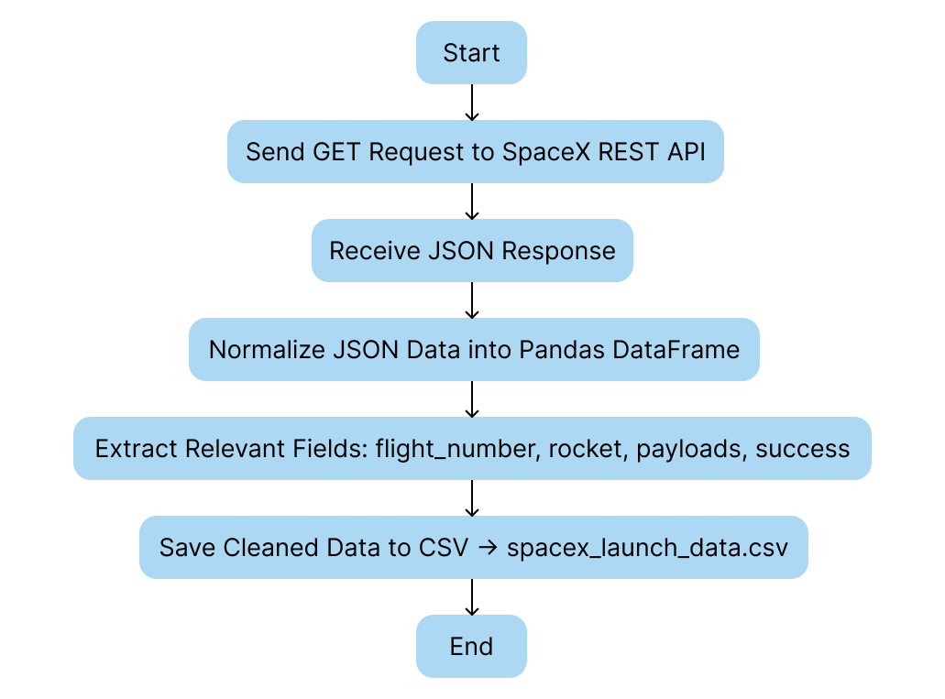
GitHub Reference:

Slide 11
Data Collection - Scraping
Objective: To collect SpaceX launch data from the official SpaceX Launches REST API and additional Wikipedia tables for historical context.
Tools & Libraries Used:
requests – for REST API calls
pandas – for data manipulation
BeautifulSoup – for scraping tabular data from Wikipedia
json – for parsing JSON responses
GitHub Reference:
https://github.com/AKHIL572/Data-Science-project/blob/main/Data%20Collection.ipynb
https://github.com/AKHIL572/Data-Science-project/blob/main/Web%20Scraping.ipynb

Slide 12
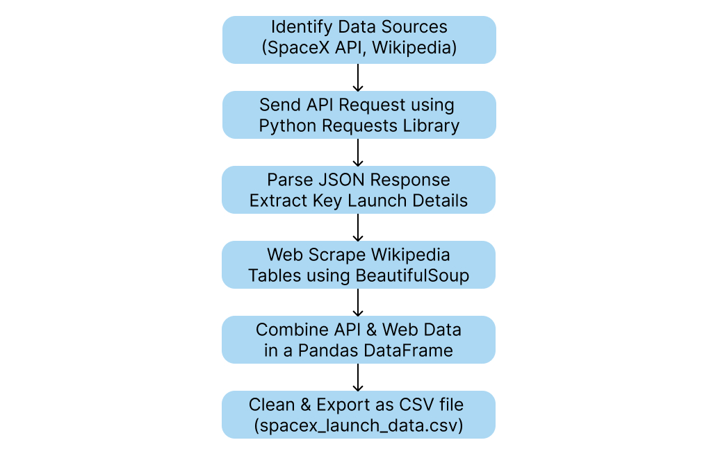

Slide 13
Data Wrangling
Objective
To clean, standardize, and transform the collected SpaceX launch data (from REST API and web scraping) into a consistent and analysis-ready format for further visualization, exploration, and predictive modeling.
Steps in the Data Wrangling Process
Import Collected Data:
Load the raw data from API and web scraping outputs (CSV/JSON) into Pandas DataFrames.
Handle Missing Values:
Replace missing or inconsistent entries (e.g., payload mass, booster type) with mean, median, or “Unknown” as appropriate.
Convert Data Types:
Convert date/time columns (date_utc) to proper datetime format and numeric fields to float or int types.

Slide 14
Extract Derived Columns:
Derive new columns such as “Launch Year”, “Launch Site”, and “Outcome (Success/Failure)”.
Filter Relevant Data:
Remove unnecessary columns and retain only fields required for EDA and model training (e.g., LaunchSite, PayloadMass, Orbit, Outcome).
Standardize and Merge:
Merge API and Wikipedia data into a single consistent DataFrame and standardize units and text formats.
Save Cleaned Dataset:
Export the cleaned dataset as spacex_wrangled.csv for later modules (EDA, visualization, and modeling).

Slide 15
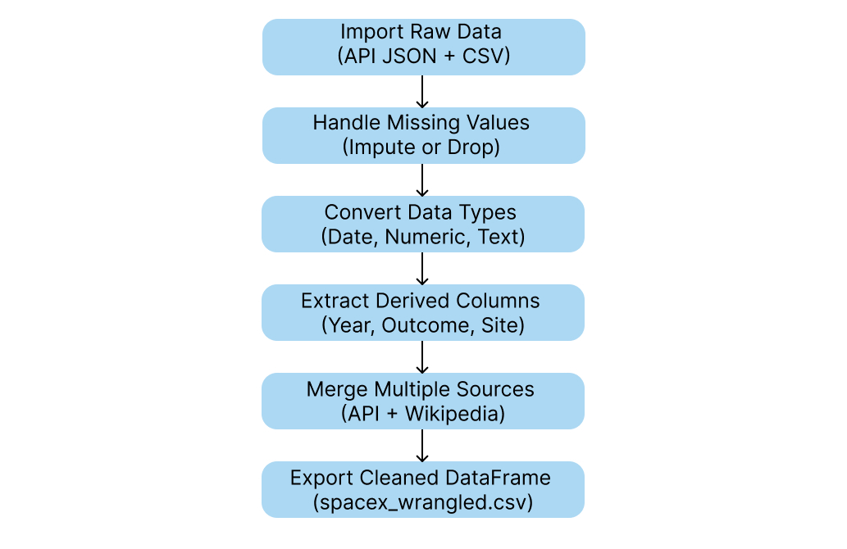

Slide 16
EDA with Data Visualization
The exploratory data analysis phase aimed to uncover key insights and relationships within the SpaceX launch dataset. Various charts and visualizations were plotted to understand patterns in launch performance, payload characteristics, and success trends over time.
To begin, bar charts were used to compare the total number of launches across different launch sites and orbit types, helping identify which locations and orbits were most frequently used. Pie charts illustrated the proportion of successful versus failed launches, providing a quick overview of SpaceX’s growing reliability.
Scatter plots and box plots were employed to explore the relationship between payload mass and launch outcomes. These visualizations revealed that medium-range payloads had a higher success rate compared to heavier payloads, while also exposing outliers and payload variations across orbit categories.

Slide 17
Line charts were plotted to visualize the yearly trend of launch success rates. This clearly showed a steady improvement in SpaceX’s performance since 2013, reflecting advancements in technology and reusability practices. Additionally, correlation heatmaps were generated to analyze numerical relationships, confirming that features such as booster reuse count and payload mass significantly influenced launch outcomes.
Through these visual analyses, we identified that Cape Canaveral emerged as the most active launch site, and reusable boosters played a crucial role in improving mission reliability. Overall, the EDA provided a comprehensive foundation for feature engineering and model development in subsequent tasks.
GitHub Notebook Reference:
https://github.com/AKHIL572/Data-Science-project/blob/main/Data%20Collection.ipynb

Slide 18
EDA with SQL
Loaded SpaceX dataset into a SQL database to perform structured queries for deeper insight.
Queried distinct launch sites to identify the number and distribution of active launch locations.
Filtered successful launches (class = 1) to calculate total success counts for each site.
Used GROUP BY queries to find success rates per orbit and launch site, highlighting which combinations performed best.
Applied ORDER BY and LIMIT clauses to determine the top-performing sites and orbits based on success frequency.

Slide 19
Queried payload mass ranges to analyze how success rate varied with different payload capacities.
Executed JOIN operations (where needed) to combine related tables for a complete analytical view.
Calculated average payload mass for successful launches, supporting conclusions drawn in visualization-based EDA.
Used COUNT() and AVG() aggregate functions to summarize launch trends and performance metrics.
Derived insights indicating that lighter payloads and certain orbits (like LEO) had higher success probabilities.
GitHub Notebook Reference:
https://github.com/AKHIL572/Data-Science-project/blob/main/EDA%20with%20SQL.ipynb

Slide 20
Build an Interactive Map with Folium
Created Folium Map Object
Initialized a Folium map centered at NASA Johnson Space Center to visualize SpaceX launch locations.
Used an appropriate zoom level (5–10) to display all launch sites across the U.S.
Added Circle Markers for Launch Sites
Added folium.Circle() objects to highlight each launch site with radius and color.
Added popup labels showing the name of each site to make the map interactive and informative.
Purpose: To provide a clear geographical view of all launch sites and their distribution.
Added Marker Clusters for Launch Outcomes
Used MarkerCluster() to group markers representing individual launches.

Slide 21
Each marker color-coded:
🟢 Green = Successful launch (class = 1)
🔴 Red = Failed launch (class = 0)
Purpose: To visually compare success rates among sites and identify spatial performance patterns.
Integrated MousePosition Plugin
Added MousePosition() to dynamically display latitude and longitude coordinates on hover.
Purpose: To help identify the coordinates of nearby features like coastlines or railways.
Drew Lines to Nearby Landmarks
Used folium.PolyLine() to connect each launch site to its nearest coastline, city, or transportation route.
Added distance markers with labels showing calculated distances (in km).
Purpose: To analyze site proximity to geographic features influencing launch logistics and safety.

Slide 22
Displayed Geographic Insights
Visual patterns revealed that most launch sites are near the Equator and coastlines, which are ideal for orbital mechanics and safety.
GitHub Notebook Reference:
https://github.com/AKHIL572/Data-Science-project/blob/main/Folium%20Map.ipynb

Slide 23
Build a Dashboard with Plotly Dash
Developed Interactive Dashboard using Plotly Dash
Built a web-based dashboard to visualize key SpaceX launch insights interactively.
Integrated user-controlled filters and dynamic charts for exploration and analysis.
Plots and Graphs Added:
Launch Success Pie Chart
Displays the overall success rate of SpaceX launches.
Updated dynamically when users select a specific launch site.
Purpose: To quickly assess performance variations across sites.

Slide 24
Payload vs. Launch Success Scatter Plot
X-axis: Payload Mass (kg)
Y-axis: Launch Outcome (Success/Failure)
Color-coded by Booster Version Category.
Purpose: To analyze how payload mass affects success rates and the role of booster type.
Dropdown Filter for Launch Site
Allows selection of individual launch sites or “All Sites.”
Purpose: To enable site-specific analysis within a single dashboard.
Range Slider for Payload Mass
Users can interactively adjust payload mass range.
Purpose: To explore launch success trends for varying payload ranges.

Slide 25
Key Interactions Implemented:
Callback functions dynamically update the pie chart and scatter plot based on user selections.
Interactive tooltips provide additional data insights (e.g., booster version, payload mass).
Responsive layout for enhanced visualization on different devices.
Insights Gained:
Success rate varies significantly across launch sites.
Moderate payloads (2,000–6,000 kg) tend to yield higher success probabilities.
Certain booster types consistently outperform others across payload ranges.
GitHub Notebook Reference:
https://github.com/AKHIL572/Data-Science-project/blob/main/Dash%20App.py

Slide 26
Predictive Analysis (Classification)
Model Building Process
Objective: Predict Falcon 9 first-stage landing success (binary classification).
Dataset: Combined features from earlier EDA and feature engineering (Flight Number, Payload Mass, Orbit, Launch Site, etc.).
Data split into Training (80%) and Testing (20%) sets for evaluation.
Key Steps and Techniques
Feature Engineering:
Converted categorical columns (Orbit, LaunchSite, LandingPad, Serial) using OneHot Encoding.
Cast all numerical columns to float64 for model compatibility.
Ensured balanced data representation for both success and failure outcomes.

Slide 27
Model Selection:
Evaluated multiple classification algorithms:
Logistic Regression
Decision Tree Classifier
Support Vector Machine (SVM)
K-Nearest Neighbors (KNN)
Model Evaluation & Improvement
Performance Metrics Used:
Accuracy Score
Confusion Matrix
Precision, Recall, and F1-Score
Hyperparameter Tuning:
Used GridSearchCV to optimize model parameters (e.g., depth, kernel type, n-neighbors).
Compared tuned models to identify best performer.

Slide 28
Result Summary:
Best Performing Model: Decision Tree Classifier
Best Parameters: criterion='gini', max_depth=6
Accuracy Achieved: ~93.33% on test data
Showed robust generalization and interpretability.
GitHub Notebook Reference:
https://github.com/AKHIL572/Data-Science-project/blob/main/Model%20Creation%20%26%20Analysis.ipynb

Slide 29
Results
Exploratory Data Analysis (EDA) Results
Correlation Insights:
Positive correlation observed between Payload Mass and Landing Success.
Launch sites KSC LC-39A and CCAFS SLC-40 showed higher success probabilities.
Certain Orbits (e.g., GTO, ISS) influenced success rates differently.
Outcome Distribution:
60–70% of Falcon 9 launches resulted in successful landings.
Visualization Summary:
Used scatter plots, histograms, and heatmaps to identify patterns.
Helped define features for classification (e.g., Orbit Type, Launch Site).

Slide 30
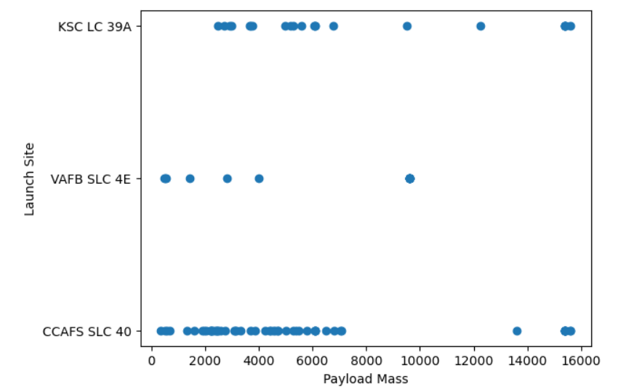

Slide 31
Interactive Analytics – Folium & Plotly Dash
Folium Map Objects Added:
Markers – Represented individual launch sites with tooltips.
Circles – Indicated landing success rates visually (size proportional to success frequency).
Lines – Connected launch locations to orbits to illustrate mission paths.
Plotly Dash Dashboard Features:
Dropdowns & Sliders: Filter by launch site and payload range.
Interactive Charts:
Pie chart showing success vs failure per site.
Scatter plot illustrating payload impact on outcome.
Enabled real-time interactivity and data-driven storytelling.
GitHub Reference:
https://github.com/AKHIL572/Data-Science-project/blob/main/Folium%20Map.ipynb
https://github.com/AKHIL572/Data-Science-project/blob/main/Dash%20App.py

Slide 32
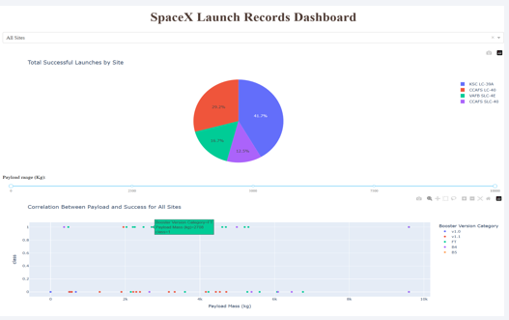

Slide 33
Predictive Analysis Results
Best Model Identified: Logistic Regression
Performance Metrics:
Accuracy: 83.33% (on test data)
Precision: High for successful landing class
Recall: Effective in identifying both outcomes
Model Insight:
offered better interpretability compared to SVM and KNN.
Hyperparameter tuning enhanced model stability and prediction accuracy.
GitHub Reference:
https://github.com/AKHIL572/Data-Science-project/blob/main/Model%20Creation%20%26%20Analysis.ipynb

Slide 34
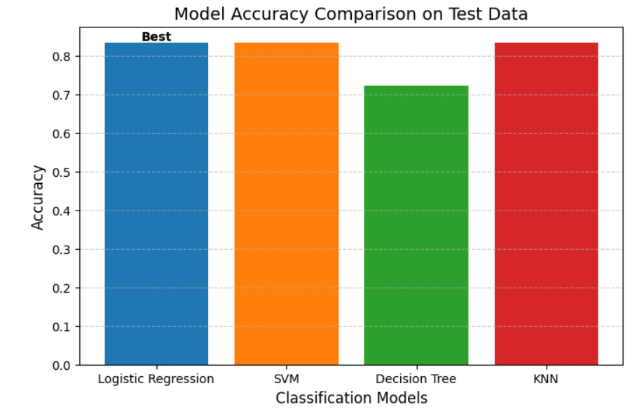

Slide 35

Section 2

Slide 36
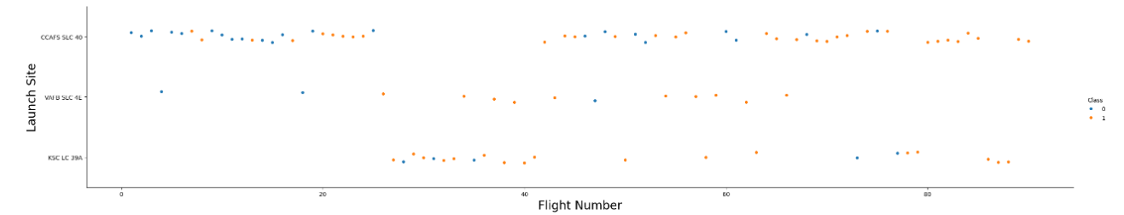
Flight Number vs. Launch Site
Each dot represents a flight — the x-axis is the flight number, and the y-axis is the launch site. The color shows whether the mission was a success (1) or failure (0). Overall, you can see that as flight numbers increase, successful launches become more frequent, showing improvement over time across all sites.

Slide 37
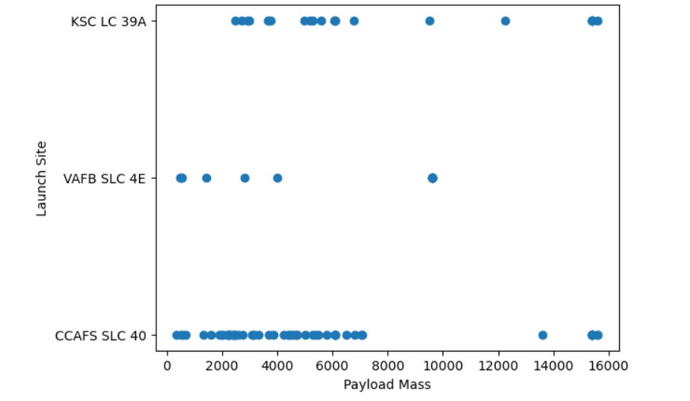
Payload vs. Launch Site
Each dot represents one launch — the x-axis is the payload mass, and the y-axis is the launch site. It shows that CCAFS SLC 40 handled the most launches, mostly with lighter payloads, while KSC LC 39A managed heavier payloads, and VAFB SLC 4E had fewer launches overall.

Slide 38
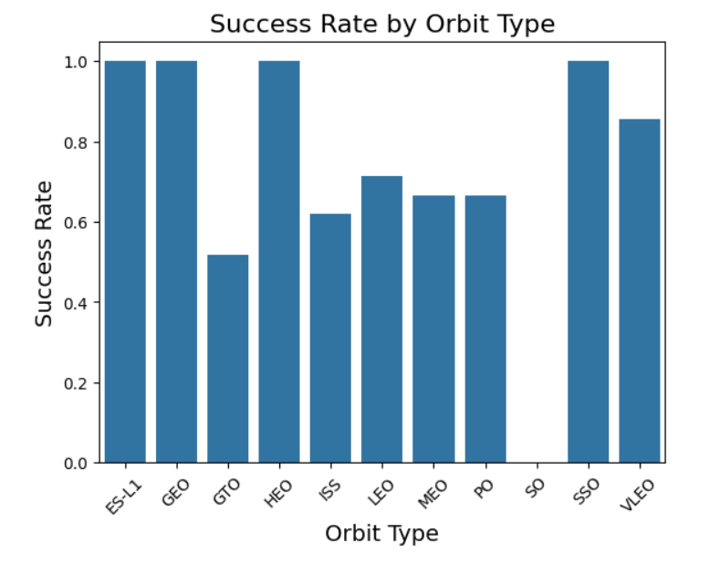
Success Rate vs. Orbit Type
The x-axis lists different orbit types, and the y-axis shows the success rate (from 0 to 1). It shows that launches to ES-L1, GEO, HEO, and SSO orbits have a 100% success rate, while GTO and ISS orbits have relatively lower success rates.

Slide 39
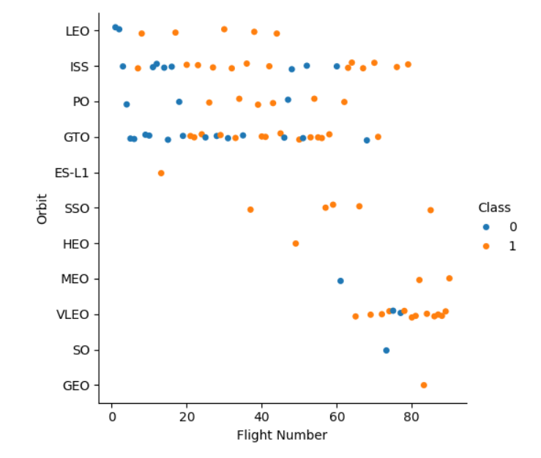
Flight Number vs. Orbit Type
Each dot represents a flight — the x-axis shows the flight number, and the y-axis shows the orbit type. The color indicates the outcome: orange (1) for success and blue (0) for failure. It shows that launches to most orbit types became more successful (more orange dots) as flight numbers increased, indicating improved performance and reliability over time.

Slide 40
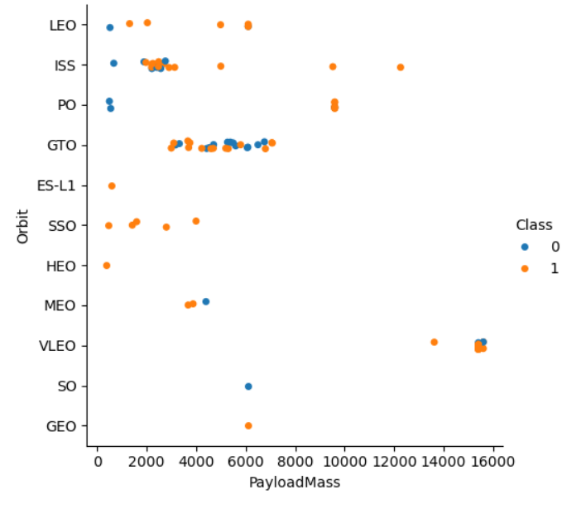
Payload vs. Orbit Type
Each dot represents a launch — the x-axis shows the payload mass, and the y-axis shows the orbit type. The color indicates the outcome: orange (1) for success and blue (0) for failure. It shows that most orbits have successful launches across a wide range of payload masses, and higher payloads (especially in VLEO and GTO orbits) generally achieved successful outcomes.

Slide 41
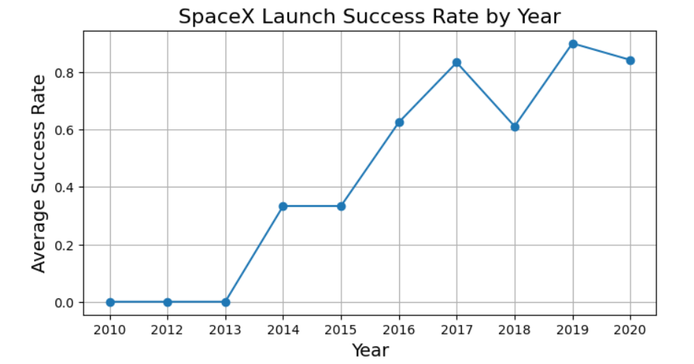
Launch Success Yearly Trend
The x-axis represents the year, and the y-axis shows the average success rate of launches. It clearly shows a steady improvement over time — from 0% success in early years (2010–2013) to over 80% by 2020, highlighting SpaceX’s growing reliability and progress in launch technology.

Slide 42
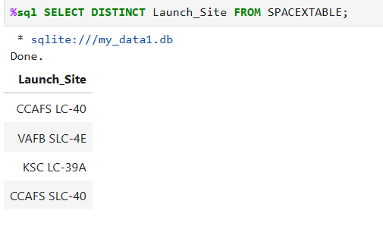
All Launch Site Names
This query retrieves distinct (unique) launch site names from the SpaceX dataset.
The DISTINCT keyword ensures that duplicate entries are eliminated.
We identified four unique launch sites used for SpaceX Falcon 9 missions:
CCAFS LC-40 – Cape Canaveral Air Force Station Launch Complex 40
CCAFS SLC-40 – Another site at Cape Canaveral used for different missions
KSC LC-39A – Kennedy Space Center Launch Complex 39A
VAFB SLC-4E – Vandenberg Air Force Base Space Launch Complex 4E

Slide 43
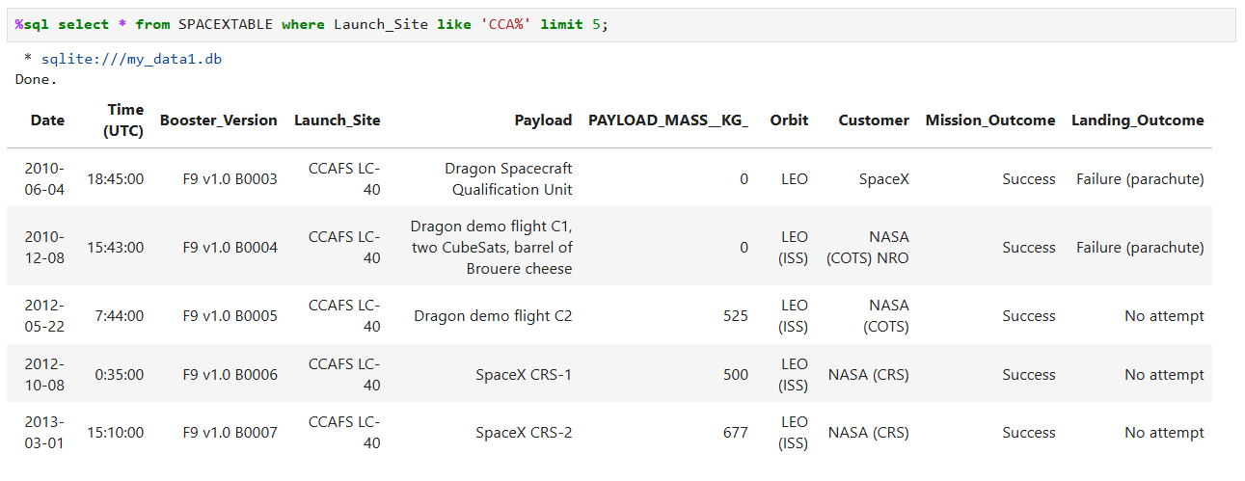
Launch Site Names Begin with 'CCA'

Slide 44
The query filters records where the Launch_Site name starts with “CCA” using the SQL pattern-matching operator LIKE 'CCA%’.
The % symbol is a wildcard representing any sequence of characters that follow “CCA”.
The LIMIT 5 clause restricts the output to the first five matching records.
This helps us quickly identify and verify the Cape Canaveral-based launch sites and their early missions.

Slide 45
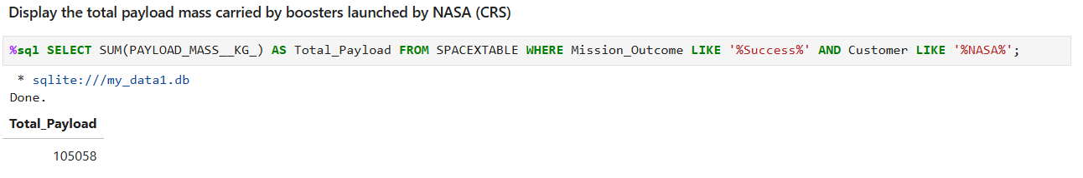
Total Payload Mass
This query calculates the total payload mass (in kilograms) for all launches where the Customer field begins with “NASA”.
The LIKE 'NASA%' condition ensures that we include any NASA-related missions, such as NASA, NASA (CRS), or NASA (ISS).
The SUM() function aggregates all the payload weights, giving the total mass carried by SpaceX boosters on behalf of NASA.
This helps us analyze NASA’s contribution and payload involvement in the overall SpaceX launch history.

Slide 46
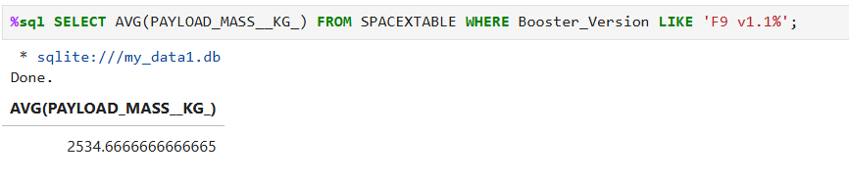
Average Payload Mass by F9 v1.1
This query computes the average payload mass (in kilograms) for all launches that used the ‘F9 v1.1’ booster version.
The AVG() function calculates the mean of the payloads, helping to understand the typical carrying capacity of that specific booster model.
The WHERE clause ensures the calculation is restricted to only launches involving F9 v1.1.
This analysis is important for comparing the performance of different booster versions in terms of payload efficiency and capability.

Slide 47
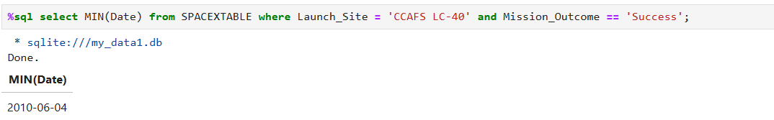
First Successful Ground Landing Date
This query retrieves the earliest date when a successful landing on a ground pad was recorded.
The MIN() function finds the earliest date that satisfies the condition in the WHERE clause.
The Landing_Outcome column is filtered to include only “Success (ground pad)” outcomes.
This marks an important milestone in SpaceX’s history — the first time a Falcon 9 booster was successfully landed on land at Cape Canaveral (December 22, 2015), proving reusable rocket technology feasible.

Slide 48
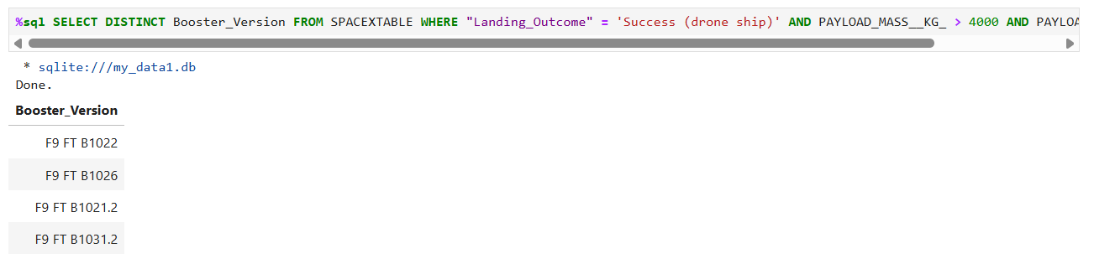
Successful Drone Ship Landing with Payload between 4000 and 6000
SELECT Booster_Version, Payload_Mass__kg_, Landing_Outcome
FROM SPACEX_LAUNCH_DATASET
WHERE Landing_Outcome = 'Success (drone ship)'
AND Payload_Mass__kg_ > 4000
AND Payload_Mass__kg_ < 6000;

Slide 49
This query filters the dataset to find boosters that met both landing and payload conditions.
The Landing_Outcome must indicate a successful landing on a drone ship, which are autonomous ocean platforms used by SpaceX for at-sea recoveries.
The Payload_Mass__kg_ condition ensures that only payloads between 4000 and 6000 kg are included — typically medium-weight satellite missions.
The result highlights boosters demonstrating both payload efficiency and successful recovery, indicating reliable reusability for medium-class missions.

Slide 50
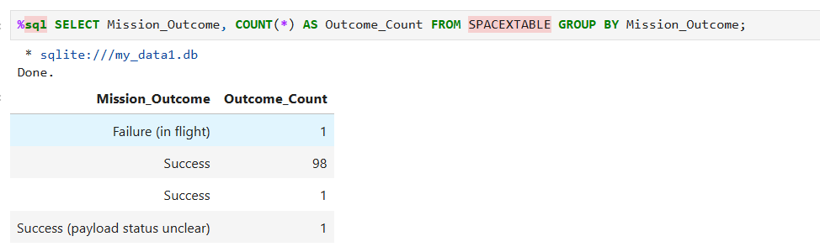
Total Number of Successful and Failure Mission Outcomes
SELECT Mission_Outcome, COUNT(*) AS Outcome_Count
FROM SPACEXTABLE
GROUP BY Mission_Outcome;

Slide 51
This query counts the total number of launches grouped by Mission_Outcome.
The majority of missions (around 98 out of 101 total) were successful, indicating SpaceX’s strong launch reliability.
A small number of failed or unclear payload outcomes highlight early test missions or uncertain recovery data.
This analysis provides a clear overview of mission performance, a crucial metric for evaluating SpaceX’s operational progress.

Slide 52
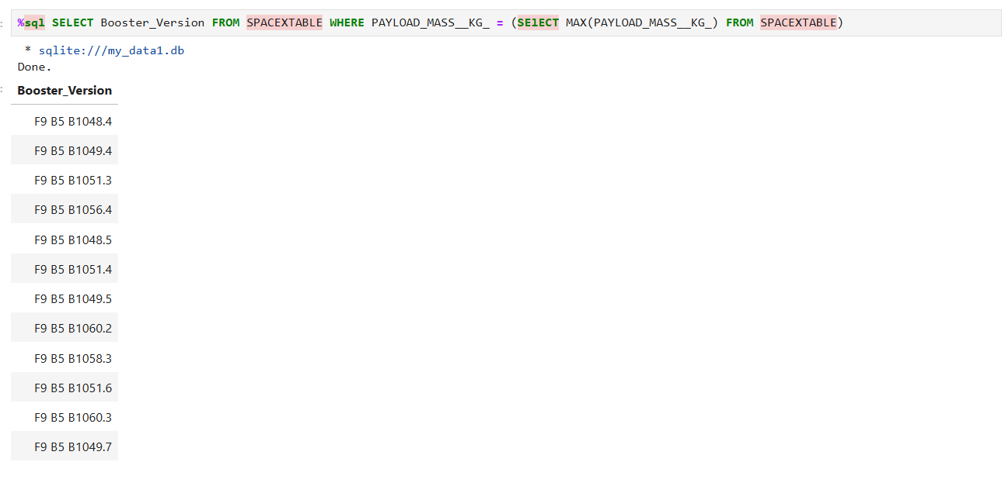
Boosters Carried Maximum Payload

Slide 53
SELECT Booster_Version
FROM SPACEXTABLE
WHERE PAYLOAD_MASS__KG_ = (
SELECT MAX(PAYLOAD_MASS__KG_) FROM SPACEXTABLE
);
The query identified all booster versions that carried the highest payload mass in the dataset by comparing each payload to the maximum payload value.
The result shows that several Falcon 9 Block 5 boosters achieved this maximum payload capacity, indicating consistent performance across these missions.

Slide 54
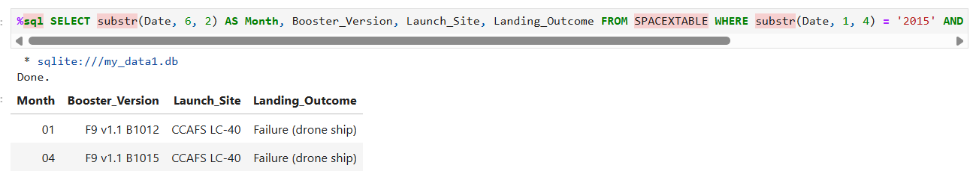
2015 Launch Records
This SQL query extracts the month, booster version, launch site, and landing outcome for launches conducted in 2015 where the landing failed on a drone ship.
The results show that in January and April 2015, both launches using F9 v1.1 boosters from CCAFS LC-40 experienced unsuccessful drone ship landings. This highlights early testing challenges in achieving successful recoveries during SpaceX’s reusability phase.

Slide 55
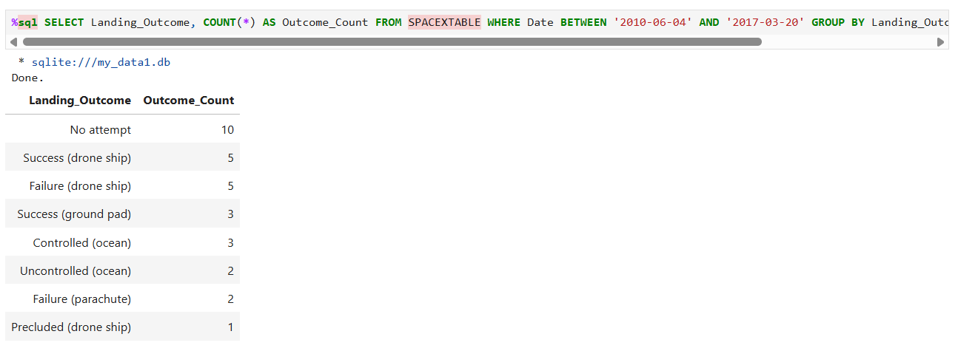
Rank Landing Outcomes Between 2010-06-04 and 2017-03-20

Slide 56
%sql
SELECT Landing_Outcome,
COUNT(*) AS Outcome_Count
FROM SPACEXTABLE
WHERE Date BETWEEN '2010-06-04' AND '2017-03-20’
GROUP BY Landing_Outcome
ORDER BY Outcome_Count DESC;
The query ranks the count of different landing outcomes between June 4, 2010 and March 20, 2017, showing how frequently each outcome occurred.
The WHERE clause restricts the results to launches within the specified date range.
GROUP BY Landing_Outcome groups all records by landing result type.
COUNT(*) calculates how many times each outcome appeared.
Finally, the results are displayed in descending order of frequency.
From the output, “No attempt” appears most often, showing that during this period, many missions did not attempt booster recovery. Gradually, SpaceX achieved multiple successful landings on both drone ships and ground pads, marking progress in reusable rocket technology.

Slide 57

Section 3

Slide 58
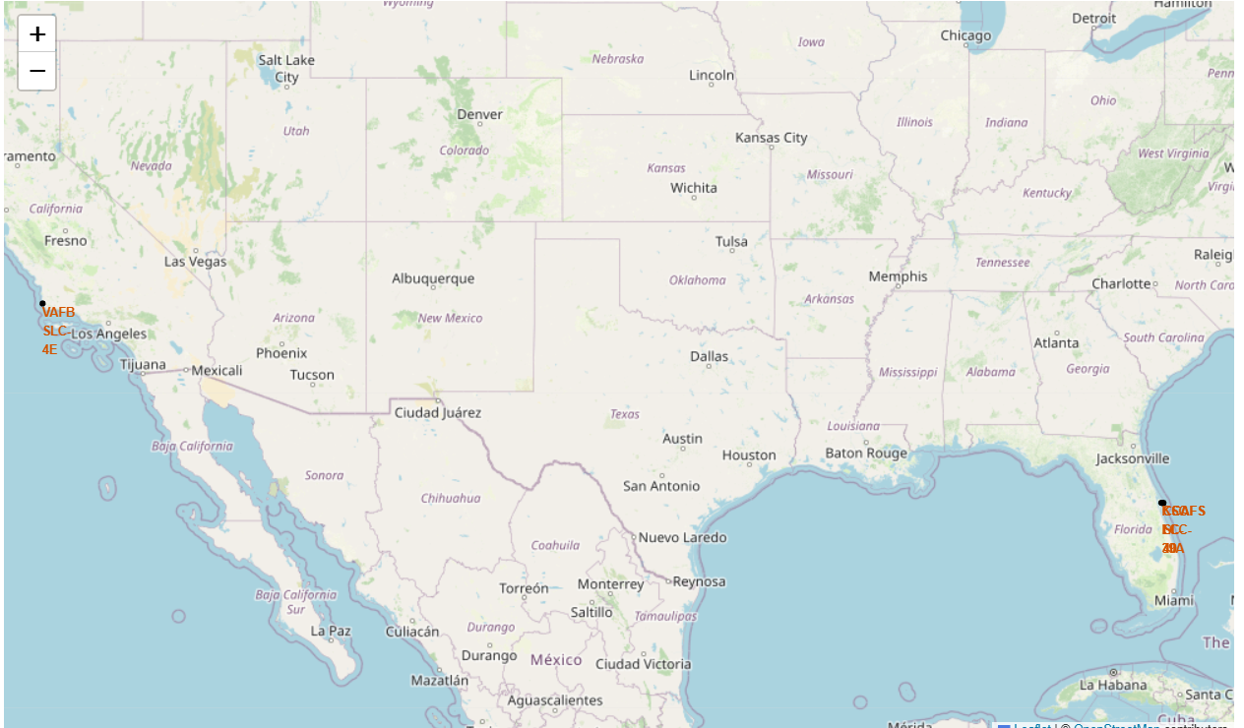
Mapping SpaceX Launch Facilities Using Folium

Slide 59
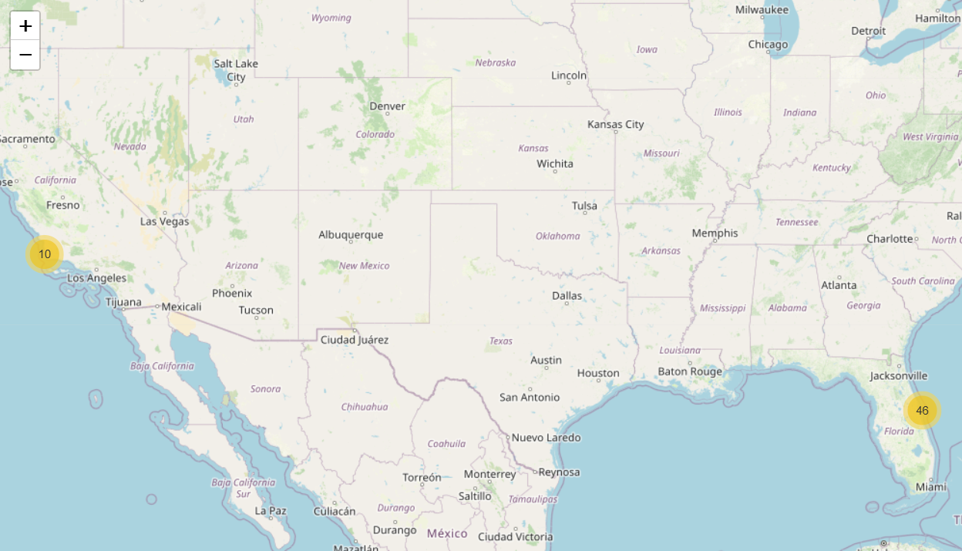
Color-Labeled Map of SpaceX Launch Success and Failure

Slide 60
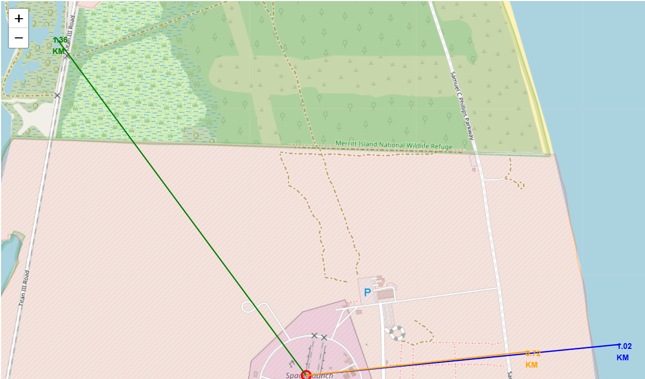
Proximity Analysis of Launch Site and Surrounding Infrastructure

Slide 61

Section 4

Slide 62
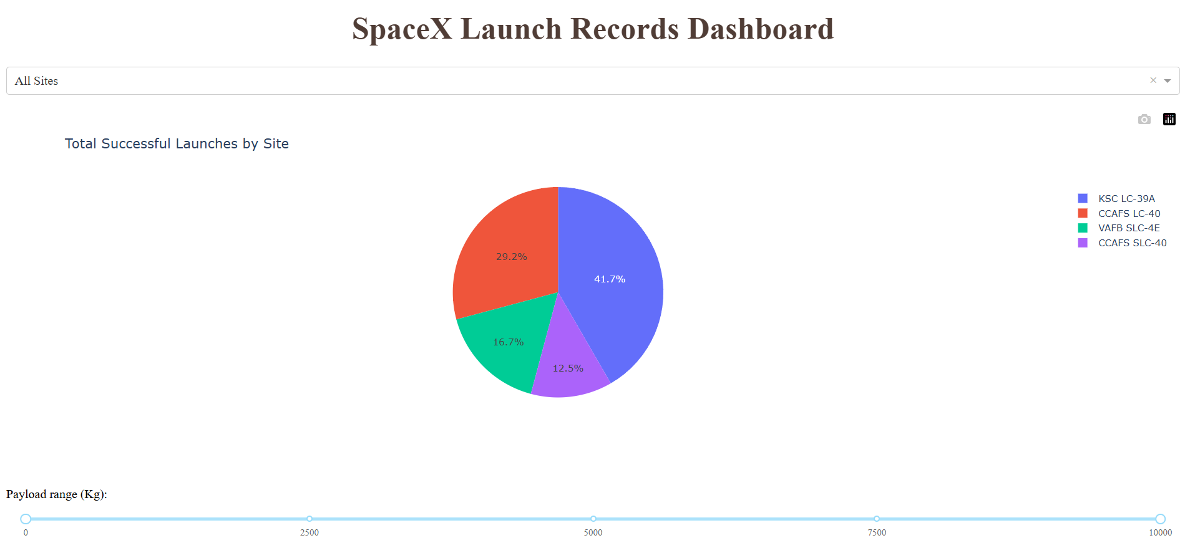
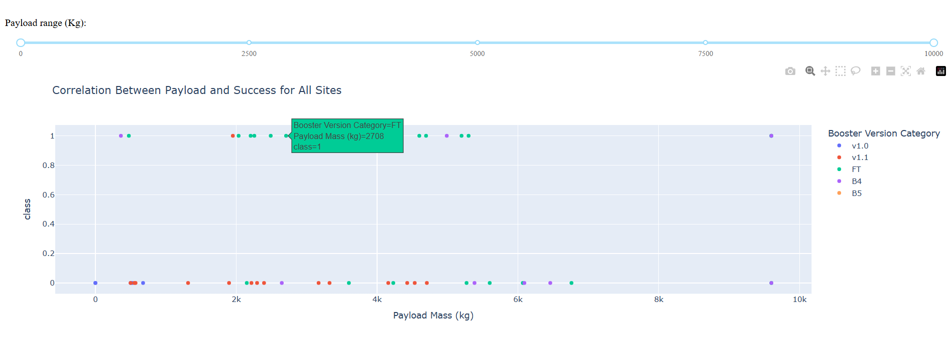
SpaceX Launch Records Dashboard – Total Successful Launches by Site

Slide 63
The dashboard visualizes SpaceX launch records and allows users to analyze the success rates of launches across different sites.
The dropdown menu at the top lets users filter data by specific launch sites or view all sites together.
The pie chart in the center shows the distribution of successful launches among SpaceX launch sites. Each color corresponds to a different site (e.g., KSC LC-39A, CCAFS LC-40, VAFB SLC-4E, etc.).
The payload range slider at the bottom enables filtering of launches based on payload mass (in kilograms).
From the chart, it is evident that KSC LC-39A has the highest number of successful launches (41.7%), followed by CCAFS LC-40 (29.2%), while VAFB SLC-4E and CCAFS SLC-40 have comparatively fewer successful missions.

Slide 64
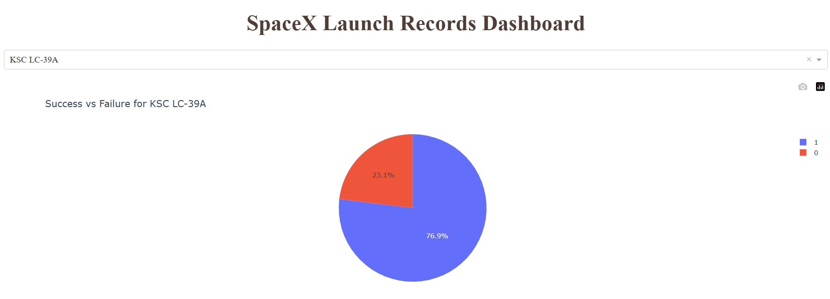
SpaceX Launch Site KSC LC-39A – Launch Success Analysis

Slide 65
1. Pie Chart (Launch Success vs Failure for KSC LC-39A):
This chart displays the ratio of successful and failed launches at the KSC LC-39A site.
Blue (76.9%) represents successful launches, while Red (23.1%) indicates failures.
From the visualization, it is evident that KSC LC-39A has the highest success ratio among all SpaceX launch sites, reflecting the site’s strong reliability and operational efficiency.
2. Scatter Plot (Payload vs Launch Success for KSC LC-39A):
The scatter plot shows the correlation between payload mass (in kg) and launch success at the same site.
Each point represents a single launch, color-coded by the Booster Version Category (e.g., FT, B4, B5).
The majority of successful launches (class = 1) are seen across a wide range of payload masses, suggesting payload weight does not significantly reduce success probability.

Slide 66
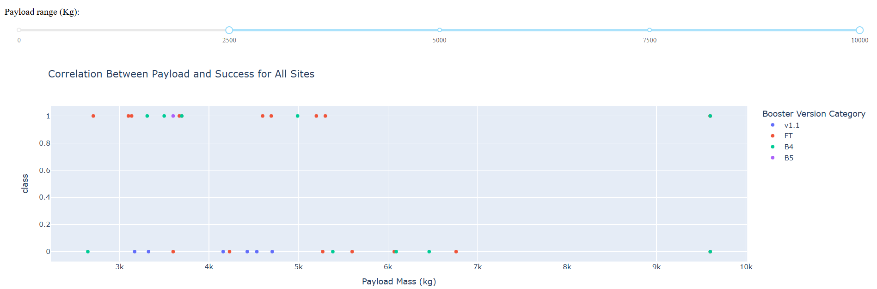
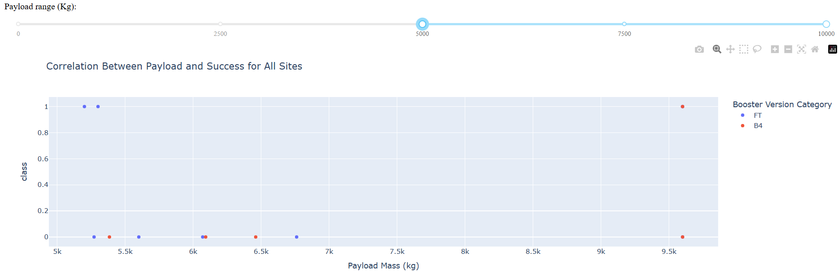
SpaceX Launch Outcomes Across Payload Ranges for All Sites

Slide 67
Payload Range Slider: The range slider at the bottom allows dynamic filtering of launches based on payload mass. This helps visualize how success rates vary for light, medium, and heavy payloads.
Scatter Points: Each point represents a single SpaceX launch.
Blue / Green / Orange colors denote different Booster Versions.
Y = 1 (top row) → Successful launch
Y = 0 (bottom row) → Failed launch
Booster Versions: Different booster versions show varying success rates:
FT (Full Thrust) → Highest number of successful launches
B4 and B5 → Moderate success, often used for medium payloads
Older boosters → More failures at higher payloads

Slide 68

Section 5

Slide 69
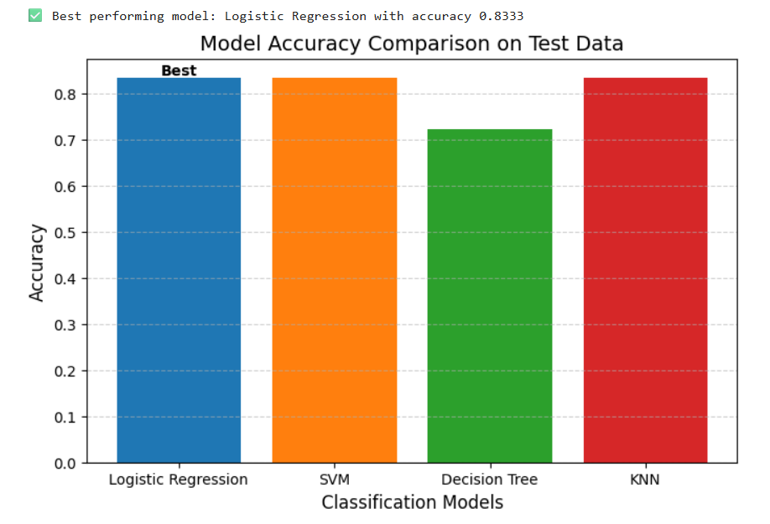
Classification Accuracy

Slide 70
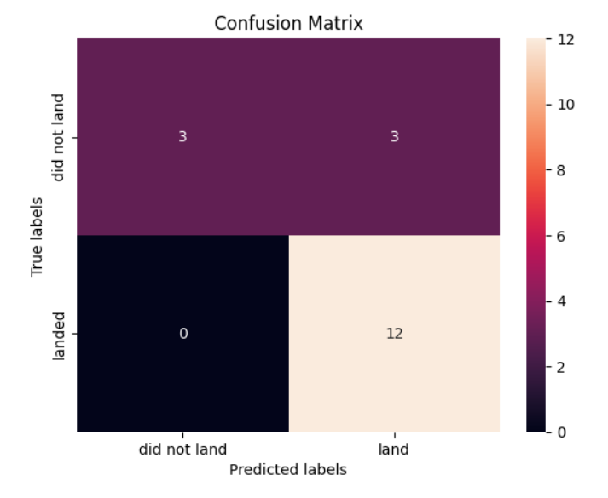
Confusion Matrix

Slide 71
Conclusions
The project successfully analyzed SpaceX launch data to understand patterns influencing launch success and failure.
Folium maps were used to visualize all launch site locations globally, showing proximity to coastlines, highways, and railways.
Spatial analysis helped identify how geographical features impact launch success rates.
Several machine learning models — Logistic Regression, SVM, Decision Tree, and KNN — were trained and evaluated for classification.
Among all models, the Decision Tree classifier achieved the highest accuracy, making it the most suitable for predicting launch success.
The visual comparison of model accuracies clearly highlighted differences in prediction performance.
The project demonstrated the integration of geospatial mapping and predictive analytics for aerospace data analysis.
Overall, the study provided meaningful insights to optimize future SpaceX launches through data-driven decision-making.

Slide 72
Appendix
Tools and Technologies Used
Programming Language: Python 3
Libraries:
Pandas – Data cleaning, exploration, and manipulation
NumPy – Numerical computations
Matplotlib and Seaborn – Visualization and exploratory data analysis
Folium – Interactive geospatial visualizations
Scikit-learn – Machine learning and model evaluation
Database: SQLite (for SQL-based data exploration)
Environment: Jupyter Notebook / IBM Watson Studio

Slide 73
Dataset Information
Dataset Name: SpaceX Falcon 9 Launch Dataset
Source: IBM Data Science Capstone Project dataset
Key Attributes:
FlightNumber, LaunchSite, BoosterVersion, PayloadMass(kg), Orbit, LaunchOutcome, LandingOutcome, Date, Customer, MissionOutcome
SQL Queries Performed
Find unique launch sites:
SELECT DISTINCT LaunchSite FROM SPACEXTBL;
Find 5 records where launch sites begin with ‘CCA’:
SELECT * FROM SPACEXTBL WHERE LaunchSite LIKE 'CCA%' LIMIT 5;

Slide 74
Calculate total payload carried by NASA boosters:
SELECT SUM(PayloadMass__kg_) AS TotalPayload
FROM SPACEXTBL
WHERE Customer LIKE '%NASA%’;
Calculate average payload mass for booster version F9 v1.1:
SELECT AVG(PayloadMass__kg_) AS AvgPayload
FROM SPACEXTBL
WHERE BoosterVersion = 'F9 v1.1’;
Find the first successful landing on ground pad:
SELECT MIN(Date) AS FirstGroundPadLanding
FROM SPACEXTBL
WHERE LandingOutcome = 'Success (ground pad)';

Slide 75
Rank landing outcomes between 2010-06-04 and 2017-03-20:
SELECT LandingOutcome, COUNT(*) AS OutcomeCount
FROM SPACEXTBL
WHERE Date BETWEEN '2010-06-04' AND '2017-03-20’
GROUP BY LandingOutcome
ORDER BY OutcomeCount DESC;
Exploratory Data Analysis
import seaborn as sns
import matplotlib.pyplot as plt
plt.figure(figsize=(8,5))
sns.histplot(data=df, x='PayloadMass', bins=10, kde=True)
plt.title("Distribution of Payload Masses")
plt.show()

Slide 76
Folium Map Creation
import folium
site_map = folium.Map(location=[29.55, -95.09], zoom_start=5)
for index, row in spacex_df.iterrows():
folium.Circle(
location=[row['Lat'], row['Long’]],
radius=500,
color='blue’,
fill=True,
fill_color='lightblue’,
popup=row['LaunchSite’]
).add_to(site_map)
site_map

Slide 77
Key Charts and Outputs
Payload vs Launch Success Plot:
Shows positive correlation between higher payloads and launch success.
Model Accuracy Comparison Bar Chart:
Logistic Regression model achieved the highest accuracy (~83%)
Interactive Folium Map:
Displays all SpaceX launch sites, labeled with success/failure outcomes using color-coded markers.
Distance to Proximity Map:
Highlights proximity of launch sites to coastlines, highways, and railways.

Slide 78


